Slide 1
Examples of existing tools for co-design and sharing blueprints
WP1
Carmelo De Maria – UNIPI

Slide 2
Collaborative design of medical devices
e-NABLE enablingthefuture.org/
Patient innovation patient-innovation.com/
BME at UC Davis bme.ucdavis.edu/team/
ANDI (not online yet) andi-africa.org/
Biodesign (linked to a book, Stanford) ebiodesign.org/
4D4MD (3D printed medical devices ) www.3d4md.com/
3D astromed devices (medical devices for space missions) 2015.spaceappschallenge.org/challenge/3d-astromed-devices/

Slide 3
Entrepreneurial models linked to bottom-up innovation
Medtronic Eureka www.medtroniceureka.eu/
CMTC www.cmtcorp.com/solutions/
InnoCash es.slideshare.net/pcthuelva/inno-cash-web

Slide 4
Collaborative design for other (non medical) fields:
Open Source Ecology opensourceecology.org/
Appropedia www.appropedia.org/
Reprap reprap.org/
Wikipedia www.wikipedia.org/
Instructables www.instructables.com/

Slide 5
Repositories
GitHub github.com/
Sourgeforge sourceforge.net/
Thingiverse www.thingiverse.com/
YouMagine www.youmagine.com/
NIH 3D print exchange 3dprint.nih.gov/
Bioverse (Cellink company) bioverse.co
GrabCAD grabcad.com/library
Traceparts www.traceparts.com/

Slide 6
Crowdfunding
Kickstarter www.kickstarter.com/
Eppela (Italian) www.eppela.com/en

Slide 7
Other initiatives
Capacity building initiatives:
Engineering world health www.ewh.org/
International organization:
WHO with related initiatives www.who.int ; www.who.int/tdr/en/
Global medical devices Nomenclature (GMDN) www.gmdnagency.org/ (to be linked and used in UBORA)
Standardization agency of EU www.newapproach.org/topics/contacts.asp

Slide 8
Desiderata for ubora e-infrastructure

Slide 9
UBORA e-infrastructure
Four main sections:
needs identification section, open to everyone (general public, healthcare providers), aimed at identifying problems using forums and surveys, and also at generating disruptive new ideas;
a project management part, open to accredited users and coordinated by Biomedical Engineers, using specific project management tools;
a repository, for free download of projects blueprints which have passed the development phase and have been certified as compliant with European safety regulations;
a funding section, for supporting selected UBORA initiatives.

Slide 10
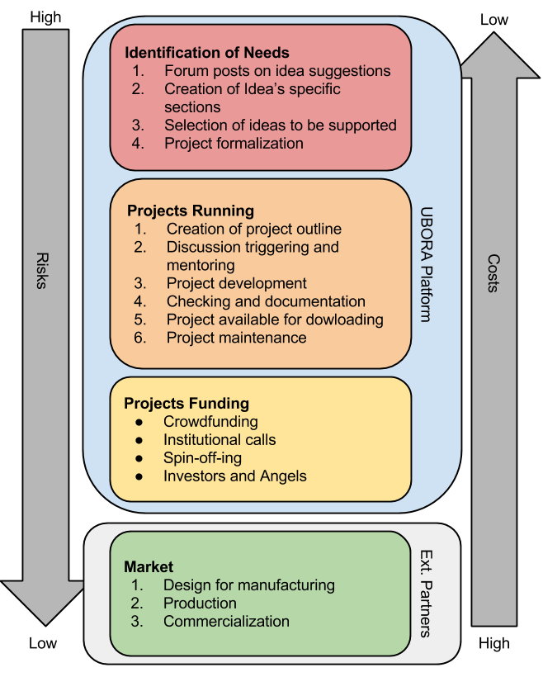
UBORA e-infrastructure

Slide 11
UBORA e-infrastructure

Slide 12
UBORA e-infrastructure

Slide 13
UBORA e-infrastructure

Slide 14
UBORA e-infrastructure

Slide 15
List of desired features
General features
Web-based application
Availability of a mobile friendly version
Overview first, zoom and filter, then details on demand,
Project managment
Issue/bug-tracking,
calender,
Gantt charts,
email notification
possibility of structuring a project into different tasks and subtasks,
possibility of showing the whole project structure at a glance
Others?

Slide 16
List of software tools that can be embedded in UBORA
Repository
Git git-scm.com/
Management applications
RedMine www.redmine.org/ (used at NASA, pub.lmmp.nasa.gov/redmine/login)
Asana www.asana.com
TeamWork www.teamwork.com
Web Documentation
MediaWiki www.mediawiki.org

Slide 17
PROPOSED STRUCTURE, EXAMPLE FOR PROMOTING VERSATILITY
UBORA:
THE PROJECT
THE PEOPLE
CASES
OF
SUCCESS
TECHNOLOGY WITHIN THE NETWORK
TEACHING & LEARNING RESOURCES
WAYS OF GETTING INVOLVED
MEDICAL NEEDS:
PHYSICIANS, PATIENTS & ASSOCIATIONS PORTAL
TECHNOLOGY OFFERS:
DESIGNERS , ENGINEERS AND MANUFACTURERS PORTAL
ADVISORS & EXPERTS:
INTERNATIONAL ASSOCIATIONS, UNIVERSITIES AND EXPERTS PORTAL
FACILITATORS &INVESTORS:
PRIVATE AND PUBLIC ORGANISMS AND PATRONS PORTAL
FUTURE PROJECTS:
NEW PARTNERS AND CONSORTIA PORTAL
Contact us
Promote or fund a project

Slide 18
Examples of “homemade” UBORA
Redmine-based http://131.114.31.96
Asana-based https://app.asana.com/
Teamwork-based https://adrod.teamwork.com/#/login

Slide 19
Software to be used
Definition of preferred (or mandatory) software to be used during the design:
Browser
CAD
Spreadsheet
...
To be discussed in the dedicated working group on the second day of this kick-off

